Slide 1


Aleria- Inclusion with Data Science
Tung-Li Wu
Quoc Tuong Lukas Dong
Tzu-Hsuan Yang

Slide 2
Table of Contents
01
02
03
Introduction
Quick summary about the data
Questions
Answering the questions
Conclusion
Actions and future research suggestions

Slide 3
Data Information/ Data Cleaning
Raw Data: Two Sheets of Excel
Participants: Participants personal information, ex: race, gender, age, organization size, satisfaction score
Experiences: Exclusion category, source, description
Data Cleaning:
Split and group categories and sources
Organize race, gender group
Classified satisfaction score to levels

Slide 4
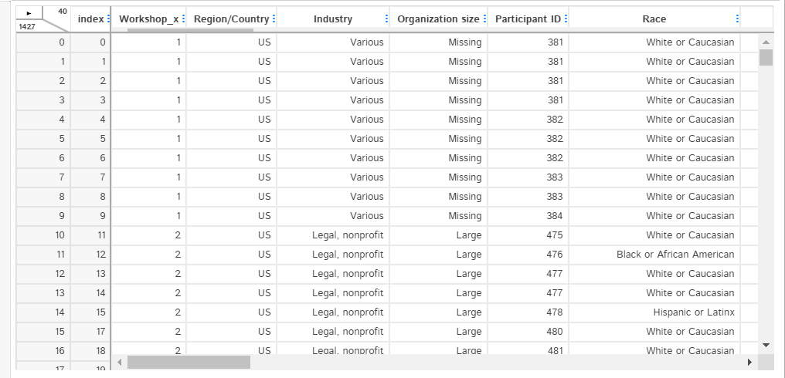
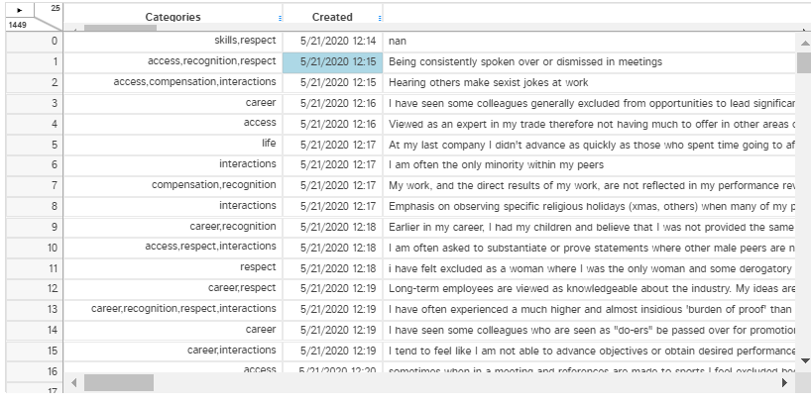
Participants
Experiences

Slide 5
Approaches
Demographic variables: Exploratory Data Analysis, Answering questions with Tableau, Excel
NLP: Exploratory Data Analysis (Topic modeling, Bag of words, Word Clouds, etc.), Answering questions with Python and Creating new variables (number of words, etc.)
Aleria’s business questions
NLP Analysis
Employees’ satisfaction
Demographic variables analysis

Slide 6
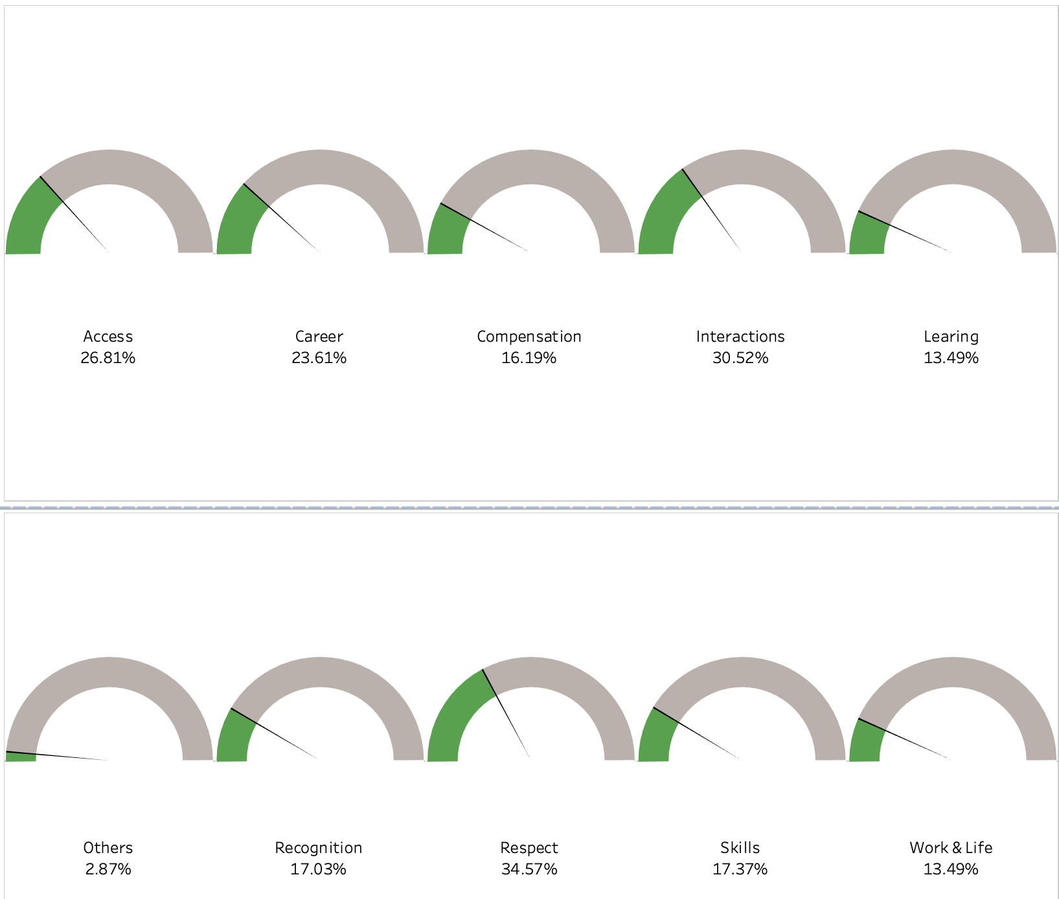
Categories (Exclusions)
Respect: Diverse perspectives are encouraged and respected
Interactions: Not being interrupted in meetings/ Having your opinion count
Access: Being able to speak with anyone in the organization/ Access to leadership and resources
Career: Clear, consistent and fair promotion processes
Skills: Tasks being assigned based on skills or capability
Recognition: Appreciation for tasks indirectly related to your role
Learning: Support for professional development
Work & Life: Availability of flex time and remote work options
Compensation: Clear and transparent compensation structure

Slide 7
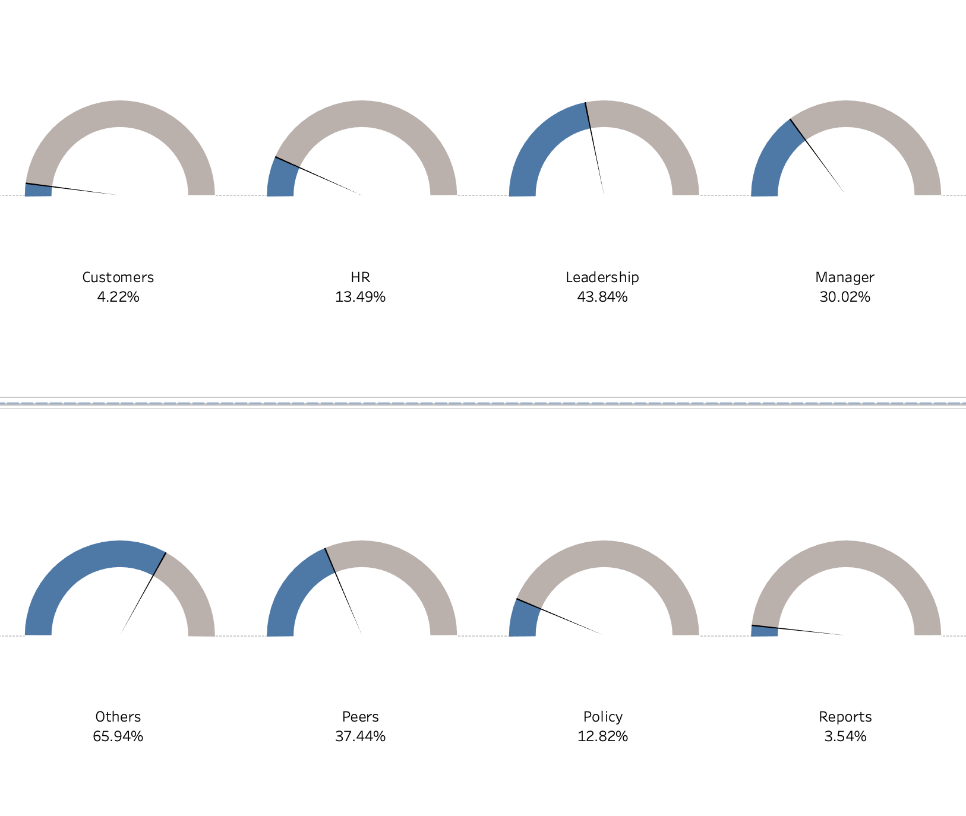
Sources
Sources of exclusions
Leadership
Peers
Manager
HR
Policy
Customers
Reports

Slide 8
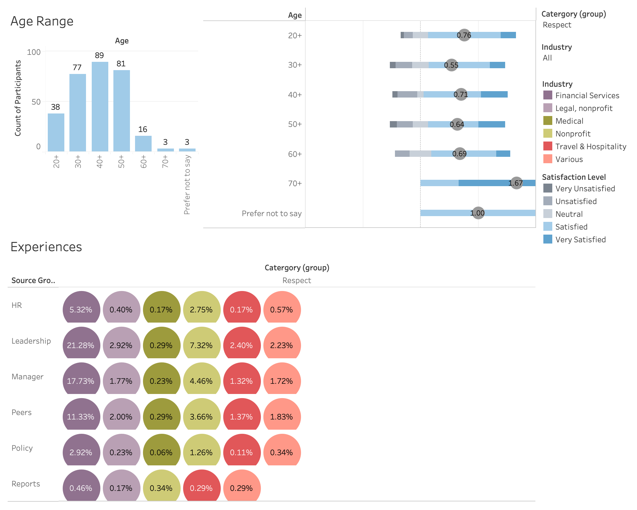
Demographics Dashboard
Designed Category and Industry as filters and are available to choose own preference
Satisfaction level categorized by satisfaction score
Average satisfaction score presented as gray circle in the Gantt Chart
Industries presented in colors
From the Dashboard, we can see the age distribution, satisfaction distribution, cited sources, and average satisfaction score in the “Respect” group.

Slide 9
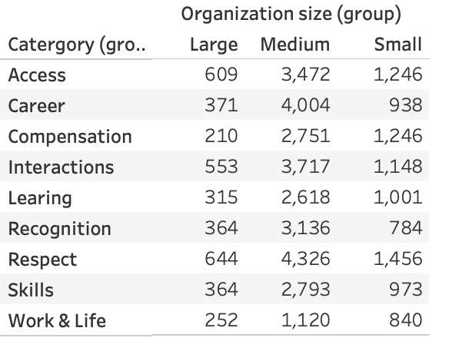
What are common experiences of exclusion that occur within companies of various sizes? Do we find that as an organization is growing, or at a certain size, that certain types of behaviors or experiences are more common?
Sizes: 1. Small (201-500) 2. Medium (<3600)
3. Large (>9000)
“Respect” ranks first
The organization size grows, the exclusions also grows.
Besides the “Career” category increases 5 times, other exclusions grow about 2.5 to 3.5 times compared to the first size.
Reason of exclusions decreased when the organization size is large: probably because the employees in large companies were not the target participants of this survey.

Slide 10
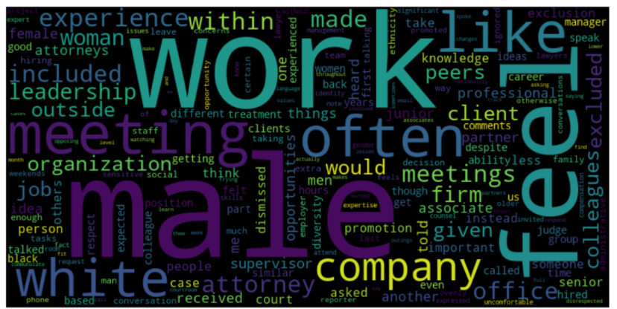
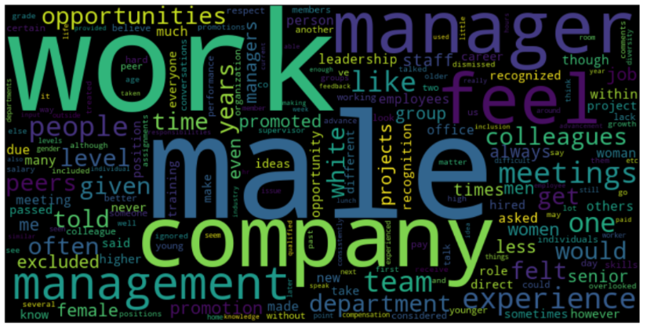
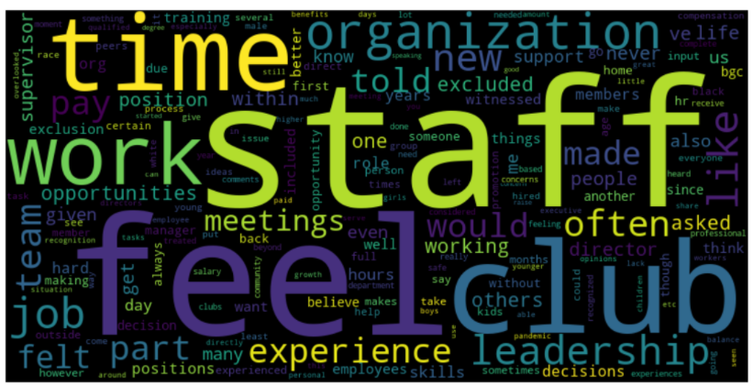

Slide 11
Size influences problems:
Small size companies: “staff”, “organization”, “time”, “meetings”.
Medium and Large: “male”, “work” , “white” take center stage and ellipse the other words’ importance.
Hypothesis: problems shift from just workplace’s characteristics to more serious issues such as gender inequality and racial biases as size grows.
>< Baert et al., stated otherwise. Suggestive evidence that Nonprofits (NGO) and public firms exhibit a lower level of discrimination compared to commercial ones
➔Aleria to eliminate the relationship between size and industry (financial/ legal are big, while non-profit is small) for better view of the picture

Slide 12
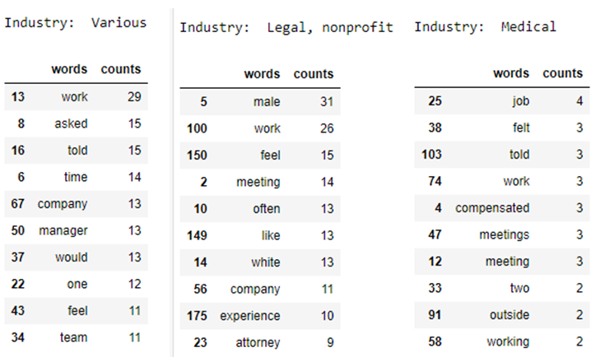
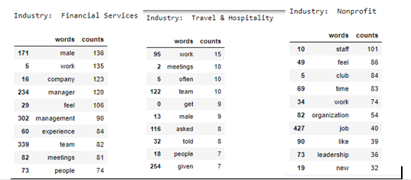
What are common experiences of exclusion within x industry?
Legal and financial: Gender and racial inequality seem to be the dominant problems in the with “male” and “white” are used frequently
Medical: seems to have more concern on compensations, meetings, or job.
Nonprofit: organizational structure and leaderships
Travel/ Hospitality: amount of unnecessary meetings and hierarchical order

Slide 13
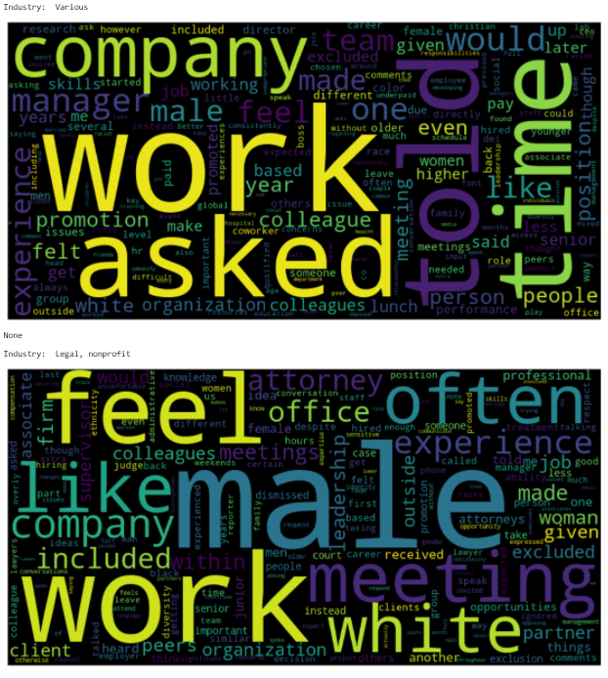
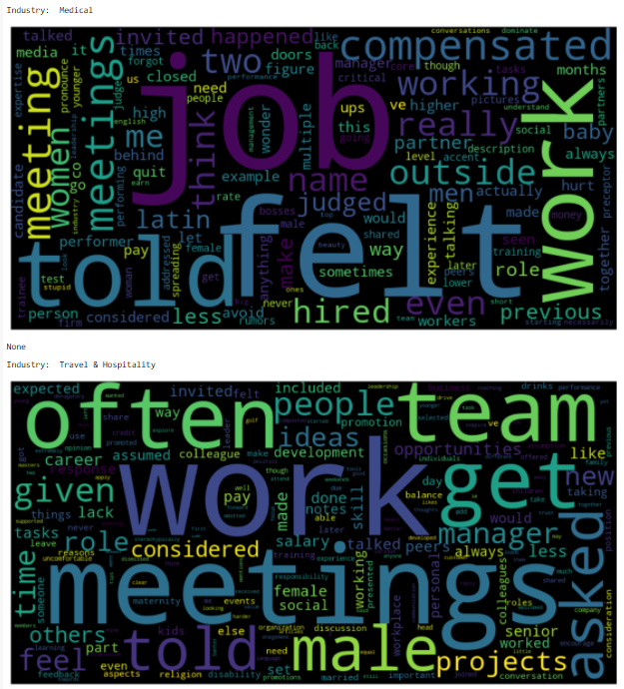
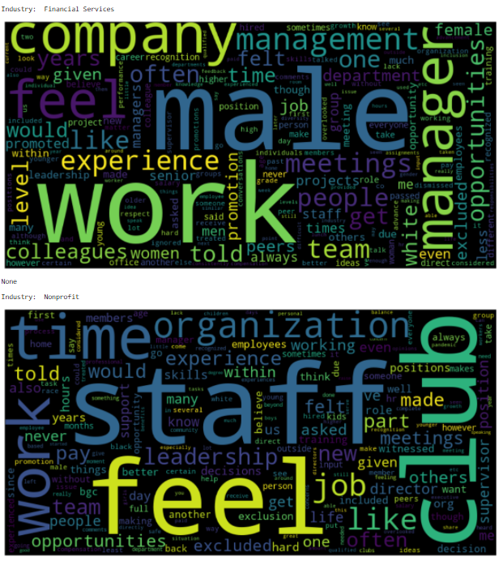
Overworks seems to be the most common complaints across every industries

Slide 14
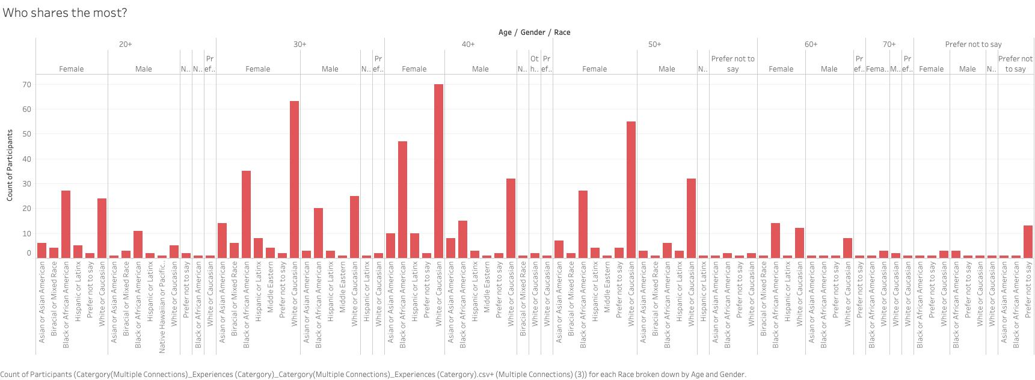
Who share the most?
40+ White or Caucasian female share the most.

Slide 15
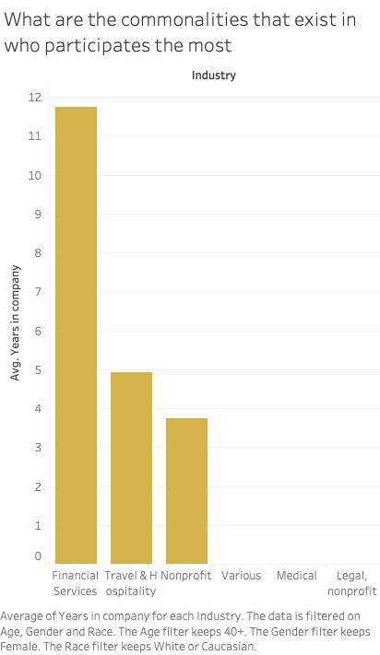
What are the commonalities that exist in who participates the least or the most?
Most of them come from Financial services industry.

Slide 16
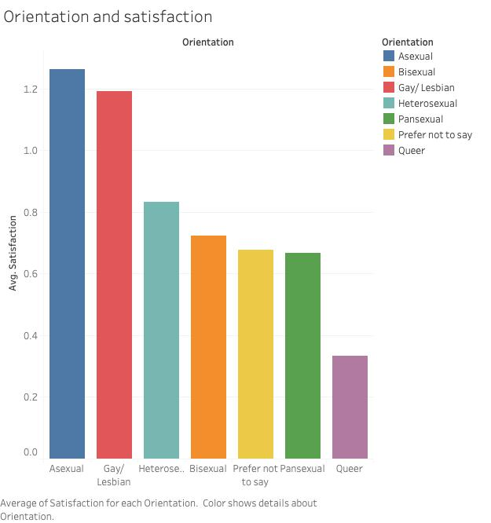
Are there demographic groups, using an intersectional lens, that experience exclusion within any category more often than others?
This chart representative orientation has not been discriminated against in the company.

Slide 17
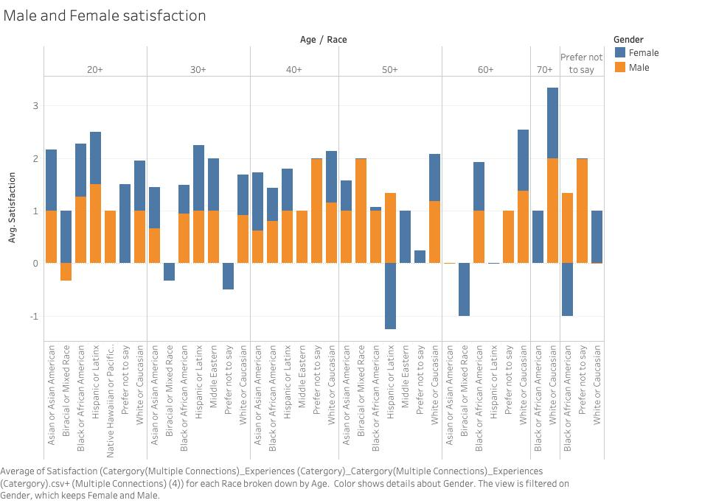
The highest satisfaction is 70 years old white or Caucasian people, and we can see the average satisfaction rate of male is relatively high.

Slide 18
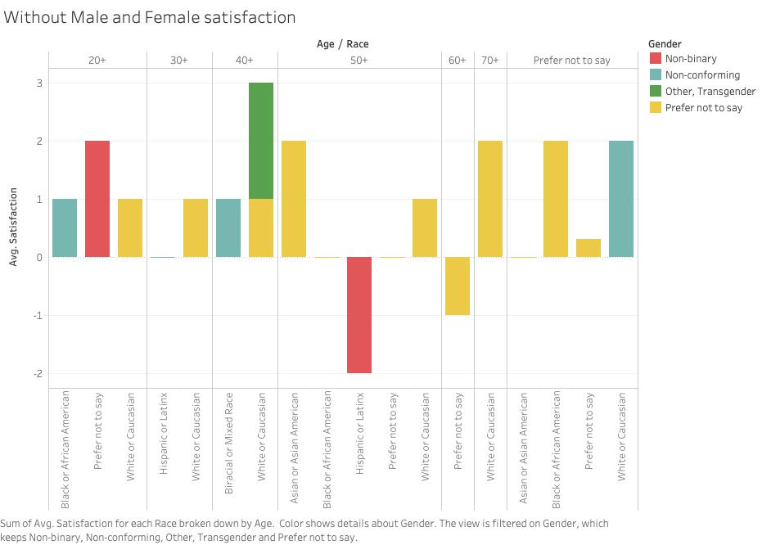
We can see most people are satisfaction, except some non-binary Hispanic or Latinx.

Slide 19
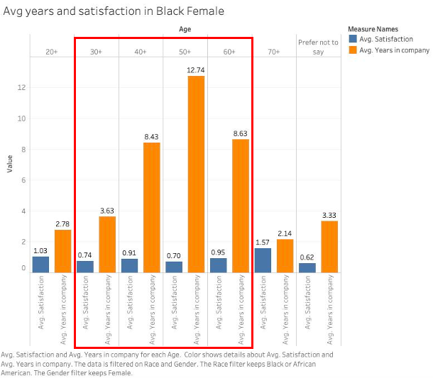
This chart shows the longer black female work in the company, the lower black female satisfaction with the company.
However, we speculate that there may be several reasons.
The longer black female stay, the less work motivation they will have, then they will feel tired of the company.
The longer black female stay, the shortcomings of the company will be discovered.
The black female between 30 and 60 years old, who may have more family pressure, for example, childbirth, raise the children, take care of family, etc.

Slide 20
Intersect group | Topics
Hispanic or Latinx, Female/ Non-Conforming, 50+/60+ | Sport events exclude them from the company and they feel like outsiders from meetings, promotions and routines No career growth opportunities for Subordinates/ supporting staff
Black or African American, Female/Prefer not to say, 50+/60+/Prefer not to say | Are asked to do a lot but are extremely underpaid and understaffed. They have to deal with a lot of hazards There are virtually no life outside of work Some members have kids, and they are not able to spend time with them on homework/ classwork
Biracial or Mixed Race, Female, 30+/50+ | Are asked to work more compared to their peers, underpaid and excluded from promotion opportunities Being undermined by outsiders while supervising many white male teammates Anti-racism initiatives are met with hostility and pushed back attitude by the higher ups
Prefer not to say, Female, 30+/40+/50+ | Skills, knowledge, experiences being underutilized, and voices, contributions go unrecognized Being misidentified racially Promotion are not based on skills
Hispanics want to feel more included;
Blacks would want to have more time for the family
Mixed Race are frustrated with anti-racism initiates being met backlash

Slide 21
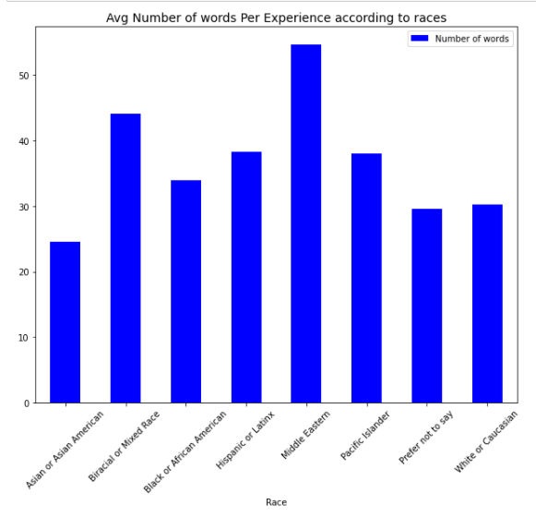
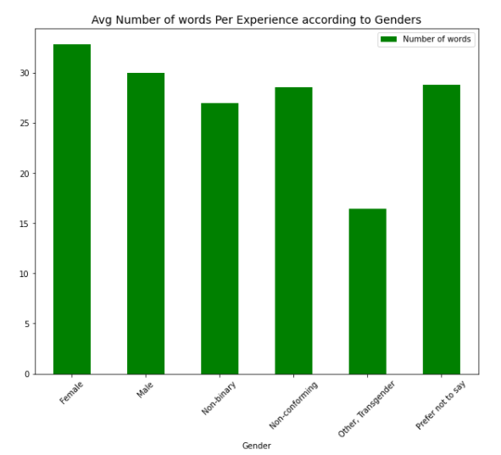
Is there a clear correlation between the level of satisfaction and the number of experiences of exclusion?
Middle Eastern and Bi Racial: write the most, at an average of 45 and 55 words/ experience respectively.
Asians: lowest numbers of words to convey their messages with only 25 words/ experience
Words/ message seems to be evenly distributed regardless of genders
Noticeable: Other, Transgender, which could be explained by the fact that we only have 2 people identify as such

Slide 22
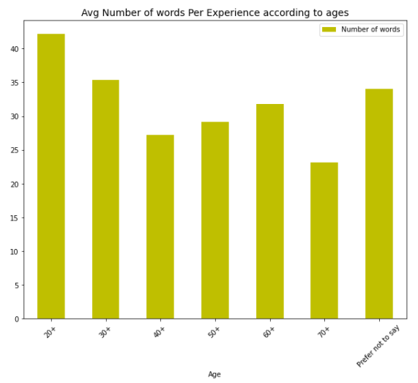
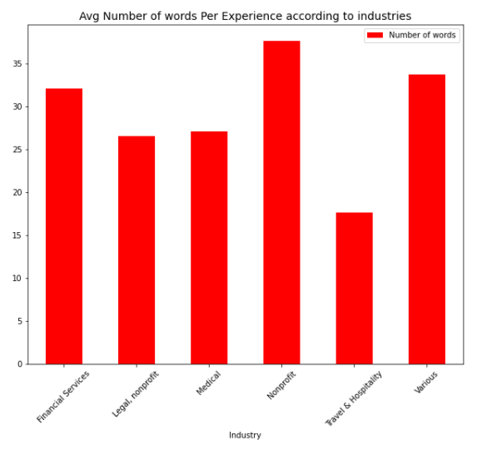
Number of words decrease as people get older talk less >40/ experience (20+) - ~22/ experience (70+)
Could be due to Aphasia
Non-profit industry being the highest at more than 35, followed by both Financial and Various at around 32

Slide 23
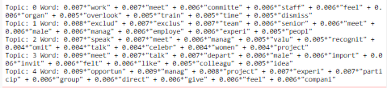
What are the most common experiences of exclusion within each category?
Categories | Topics
Access | - Skilled employees are not considered for the opportunities. Often excluded by seniors from dinners social gathering, training events , conversations, contributing ideas because of gender biases - Women are dismissed by male colleagues from decisions, project or department, meetings. They are talked over - Promotions are inaccessible and they are not attending meetings that they should have.
Career | - Being passed by for promotions or available positions even though they have the skills to do it. Organizational structure hampers growth - White males are being paid more for the same jobs. Resources go towards male colleagues if limited- Not compensated enough/ promoted for performing tasks outside of jobs or work time - Lack of female leads and positions tend to go over to male applicants
Compensation | - Poor salaries and compensation for time consuming/ high level jobs despite qualifications, degrees, performances - Not paid as much as males/ young colleagues. Some indicated that because males are the breadwinners so they should be paid more - Performance being underrated for working part time. No benefits - Contributions are being presented as higher ups’ efforts during performance reviews- Unequal distribution of work and some ask question about people with family should be paid more

Slide 24
Interactions | - Inappropriate workplace behaviors from colleagues, higher ups - Inappropriate questions/ assumption about personal lives. Passive -aggressive statements - Tensions from being the only female/ minority in the room full of males/ whites. Females are being pushed to be the “mom” of the group - Talked over, interrupted when speaking or raising concerns by seniors and managers
Learning | - Managers play favorites; only offer learning opportunities (projects, conferences, workshops, etc.)for their sex or the people they like- No learning support from the higher ups so have to do it by themselves
Life | - Medical / urgent personal problems that asked to be excused from work but got denied. - Ability/ commitment/ career growth potentials is questioned when you are a mother or have family/ kid- No family leave policy - Poor work-life balance. Expected to have no life outside of work , disregard for personal space and time after work - Demotivated by workplace gossip about untrue aspect of personal life - Some like the flexibility of work-from-home of COVID compared to rigid schedule in the past and would like to continue while others lose productivity because of distraction
Recognition | - Male colleagues re-share the same ideas get more recognitions - Minority groups (especially females) are ignored in favor of white males despite being experts - Credits are not given to where it is due. Religious minority is not really considered - Positive review but no transforming to promotion or pay raise
Respect | - Somewhat similar to “Interactions”, “Recognition”, “Compensations”, “Career” categories - Being sidelined on high paid projects, opportunities by jealous or hostile individuals. - Complaints ignored and unaddressed.
Skills | - Somewhat similar to “Recognition”, “Compensations”, “Career” categories - Undermined for being a minority or with disability and then removed from important tasks or projects that could help with career advancements- Age discrimination because the person looks young - Skills went unnoticed by the managers due to innocent oversights - Background/ Backend staffs skills are not recognized and valued - Have skills but require more trusts

Slide 25

Thanks For Listening
Please keep this slide for attribution

